Slide 1
Unit-III
Relational Model and Relational Algebra
Contents:
Introduction to the Relational Model, Relational Schema and Concept of Keys, Mapping the ER and EER Model to the Relational Model.
Relational Algebra: Unary and Set Operations, Relational Algebra Queries.
Course Outcome:
Build Relational Model from conceptual model and formulate relational algebra queries.

Slide 2
The relational model in DBMS is an abstract model used to organize and manage the data stored in a database. It stores data in two-dimensional inter-related tables, also known as relations in which each row represents an entity and each column represents the properties of the entity.

Slide 3
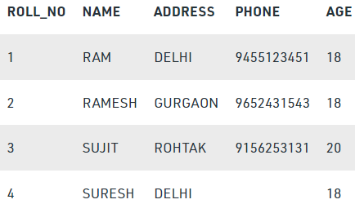
Relational Model in DBMS
Concept of Mathematical Relation and theoretically uses the concept of discrete mathematics
Relational Model was proposed by E.F. Codd to model data in the form of relations or tables.
After designing the conceptual model of Database using ER diagram, we need to convert the conceptual model in the relational model which can be implemented using any RDBMS languages like Oracle SQL, MySQL etc.
What is Relational Model?
Relational Model represents how data is stored in Relational Databases.
A relational database stores data in the form of relations (tables). Consider a relation STUDENT with attributes ROLL_NO, NAME, ADDRESS, PHONE and AGE shown in Table 1.

Slide 4
IMPORTANT TERMINOLOGIES
A table is called a relation.
Attribute (column headers): Attributes are the properties that define a relation.
e.g.; ROLL_NO, NAME
It contains the name of a column in a particular table. Each attribute Ai must have a domain, dom(Ai)
Relation Schema: A relation schema represents name of the relation with its attributes.
Describes a relation.
A relational schema contains the name of the relation and name of all columns or attributes.
Made up of a relation name R and list of Attributes (A1, A2, A3, ……..)
e.g.; STUDENT (ROLL_NO, NAME, ADDRESS, PHONE, AGE) is relation schema for STUDENT.
STUDENT (ROLL_NO: int, NAME: varchar, ADDRESS: varchar, PHONE: int, AGE: int)
If a schema has more than 1 relation, it is called Relational Schema.
Tuple: Each row in the relation is known as tuple. The above relation contains 4 tuples
Domain: It contains a set of atomic values that an attribute can take.

Slide 5
Relation Instance (Relation State): Set of tuples at a given time
The set of tuples of a relation at a particular instance of time is called as relation instance. Table 1 shows the relation instance of STUDENT at a particular time.
It can change whenever there is insertion, deletion or updation in the database.
Relation instances do not have duplicate tuples.
Relational Database Schema: set of relation schemas and a set of integrity constraints
Degree (arity): The number of attributes in the relation is known as degree of the relation.
The STUDENT relation defined above has degree 5.
Cardinality: The number of tuples in a relation is known as cardinality.
The STUDENT relation defined above has cardinality 4.
Column: Column represents the set of values for a particular attribute.
NULL Values: The value which is not known or unavailable is called NULL value.
It is represented by blank space.
e.g.; PHONE of STUDENT having ROLL_NO 4 is NULL.
Relational key: In the relational key, each row has one or more attributes. It can identify the row in the relation uniquely.

Slide 6
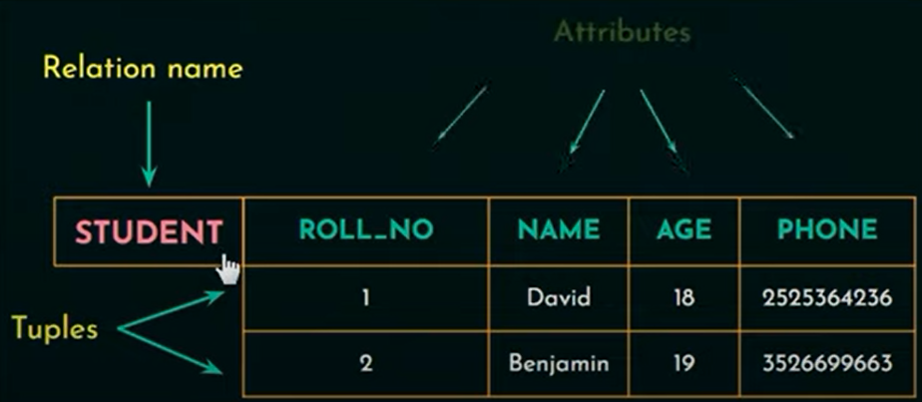

Slide 7
Relational database systems are expected to be equipped with a query language that can assist its users to query the database instances.
There are two kinds of query languages −
1. Relational Algebra - 7 fundamental operations
2. Relational Calculus - Tuple Relational Calculus (TRC)
Domain Relational Calculus (DRC)

Slide 8
Relational Algebra
Relational algebra is a procedural query language.
RA takes instances of relations as input and yields instances of relations as output.
It gives a step by step process to obtain the result of the query.
It uses operators to perform queries.
An operator can be either unary or binary.
Relational algebra is performed recursively on a relation and intermediate results are also considered as relations.

Slide 9
Unary Relational Operations
SELECT (symbol: σ)
PROJECT (symbol: π)
RENAME (symbol: ρ)
Relational Algebra Operations From Set Theory
UNION (υ)
INTERSECTION ( ),
DIFFERENCE (-)
CARTESIAN PRODUCT ( x )
Binary Relational Operations
JOIN
DIVISION

Slide 10
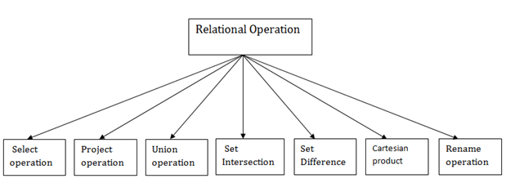

Slide 11
1. Select Operation:
The select operation selects tuples that satisfy a given predicate from a relation.
It is denoted by sigma (σ).
Notation: σ p(r)
Where:
σ is used for selection prediction r is used for relation p is used as a propositional logic formula which may use connectors like: AND OR and NOT.
These relational can use as relational operators like =, ≠, ≥, <, >, ≤.

Slide 12
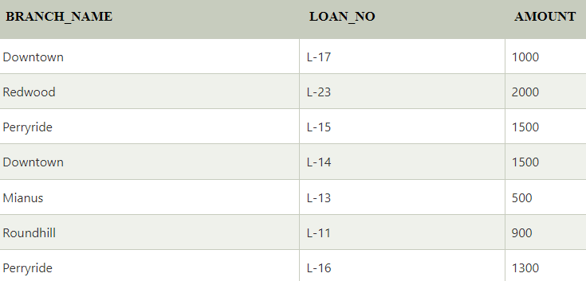
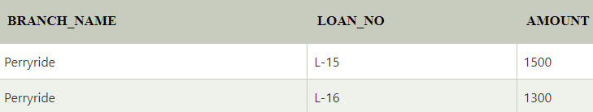
For example: LOAN Relation
Input:
σ BRANCH_NAME="perryride" (LOAN)
Output:

Slide 13
For example −
σ_{subject = "database"}(Books)
Output − Selects tuples from books where subject is 'database'.
σsubject = "database" and price = "450"(Books)
Output − Selects tuples from books where subject is 'database' and 'price' is 450.
σsubject = "database" and price = "450" or year > "2010"(Books)
Output − Selects tuples from books where subject is 'database' and 'price' is 450 or those books published after 2010.

Slide 14
2. Project Operation:
This operation shows the list of those attributes that we wish to appear in the result.
Rest of the attributes are eliminated from the table.
Duplicate rows are automatically eliminated, as relation is a set.
It is denoted by ∏.
Notation: ∏ A1, A2, An (r)
Where
A1, A2, A3 is used as an attribute name of relation r.
For example −
∏_{subject, author} (Books)
Selects and projects columns named as subject and author from the relation Books

Slide 15
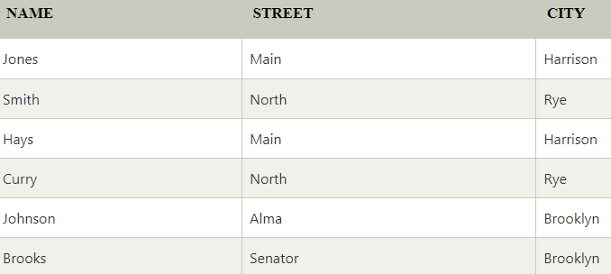
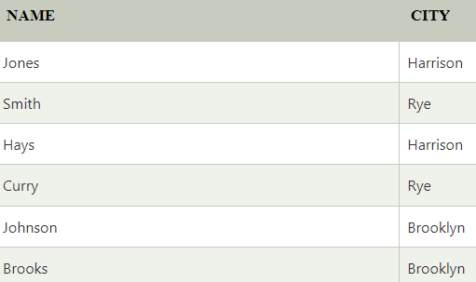
Example: CUSTOMER RELATION
Input:
∏ NAME, CITY (CUSTOMER)
Output:

Slide 16
3. Union Operation:
Suppose there are two tuples R and S.
The union operation contains all the tuples that are either in R or S or both in R & S.
It eliminates the duplicate tuples. It is denoted by ∪.
It performs binary union between two given relations and is defined as
Notation: R ∪ S = { t | t ∈ R or t ∈ S }
A union operation must hold the following conditions:
R and S must have the attribute of the same number.
Attribute domains must be compatible
Duplicate tuples are eliminated automatically.
∏ _{author} (Books) ∪ ∏ _{author} (Articles)
Output − Projects the names of the authors who have either written a book or an article or both.

Slide 17
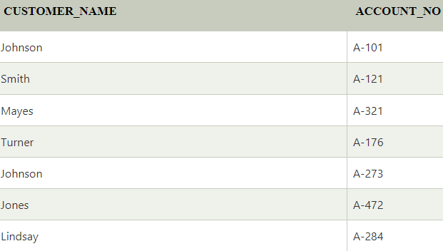
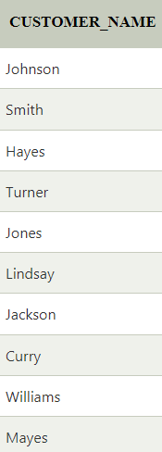
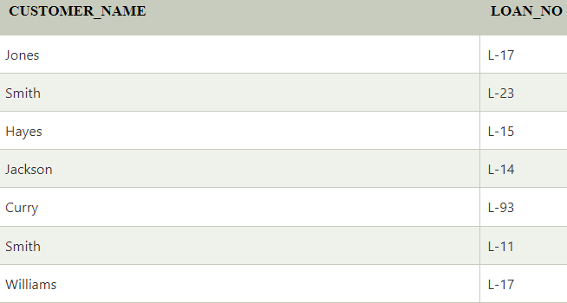
DEPOSITOR RELATION
Input:
∏ CUSTOMER_NAME (BORROW) ∪ ∏ CUSTOMER_NAME (DEPOSITOR)
BORROW RELATION

Slide 18
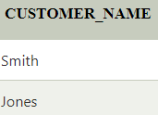
4. Set Intersection:
Suppose there are two tuples R and S. The set intersection operation contains all tuples that are in both R & S.
It is denoted by intersection ∩.
Notation: R ∩ S
Example: Using the above DEPOSITOR table and BORROW table
Input:
∏ CUSTOMER_NAME (BORROW) ∩ ∏ CUSTOMER_NAME (DEPOSITOR)
Output:

Slide 19
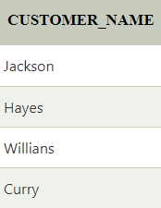
5. Set Difference:
Suppose there are two tuples R and S.
The set intersection operation contains all tuples that are in R but not in S.
It is denoted by intersection minus (-).
Notation: R - S
Example: Using the above DEPOSITOR table and BORROW table
Input:
∏ CUSTOMER_NAME (BORROW) - ∏ CUSTOMER_NAME (DEPOSITOR)
Output:
Example:
∏ _{author} (Books) − ∏ _{author} (Articles)
Output − Provides the name of authors who have written books but not articles.

Slide 20
6. Cartesian product
The Cartesian product is used to combine each row in one table with each row in the other table.
It is also known as a cross product.
It is denoted by X.
Notation: R X S
Example:
r Χ s = { q t | q ∈ r and t ∈ s}
σ_{author = 'tutorialspoint'}(Books Χ Articles)
Output − Yields a relation, which shows all the books and articles written by tutorialspoint.

Slide 21
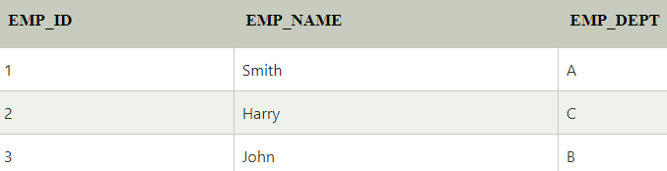
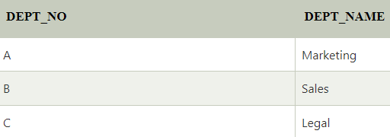
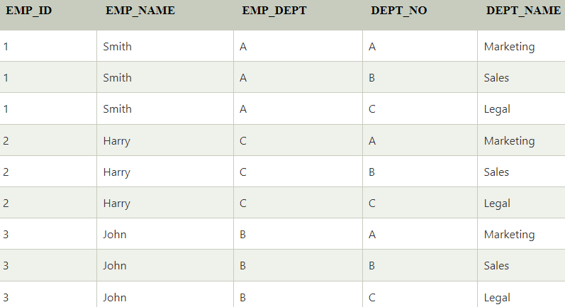
EMPLOYEE
DEPARTMENT
Input:
EMPLOYEE X DEPARTMENT
Output:

Slide 22
7. Rename Operation:
The rename operation is used to rename the output relation.
It is denoted by rho (ρ).
Example: We can use the rename operator to rename STUDENT relation to STUDENT1.
ρ (STUDENT1, STUDENT)

Slide 23
Join Operations
Join operation is essentially a Cartesian product followed by a selection criterion.
Join operation denoted by ⋈
JOIN operation also allows joining variously related tuples from different relations.
Types of JOIN:
Various forms of join operation are:
Inner Joins: Theta join EQUI join Natural join | Outer joins: Left Outer Join Right Outer Join Full Outer Join

Slide 24
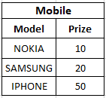
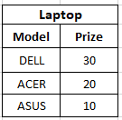
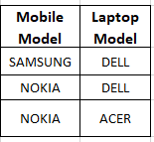
Inner Join:
In an inner join, only those tuples that satisfy the matching criteria are included, while the rest are excluded.
Theta Join:
The general case of JOIN operation is called a Theta join. It is denoted by symbol θ
Example A ⋈_{θ} B
Theta join can use any conditions in the selection criteria.
For example: Mobile ⋈ _{Mobile. price < Laptop. price} Laptop
We have to purchase both Mobile and Laptop such that price of mobile should be less than price of laptop.
A ⋈ A.column 2 > B.column 2 (B)
column 1 | column 2
1 | 2

Slide 25
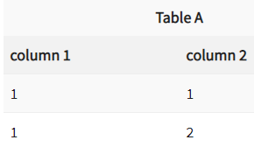
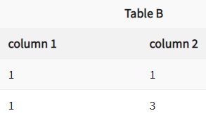
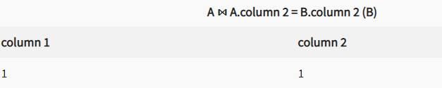
EQUI join:
When a theta join uses only equivalence condition, it becomes a equi join.
EQUI join is the most difficult operations to implement efficiently using SQL in an RDBMS and one reason why RDBMS have essential performance problems.
For example:
A ⋈ _{A.column 2 = B.column 2} (B)

Slide 26
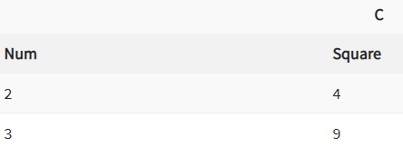
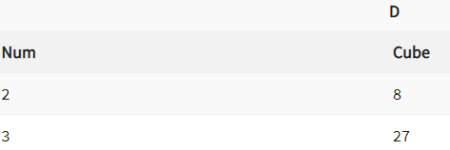
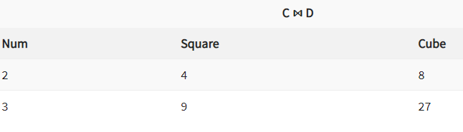
NATURAL JOIN (⋈)
Natural join can only be performed if there is a common attribute (column) between the relations. The name and type of the attribute must be same.
C ⋈ D

Slide 27
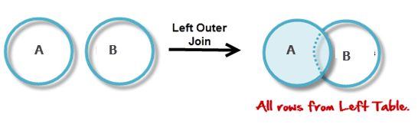
OUTER JOIN
In an outer join, along with tuples that satisfy the matching criteria, we also include some or all tuples that do not match the criteria.
Left Outer Join (A B)
In the left outer join, operation allows keeping all tuple in the left relation. However, if there is no matching tuple is found in right relation, then the attributes of right relation in the join result are filled with null values.

Slide 28
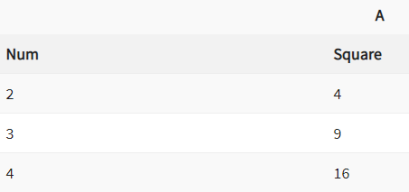
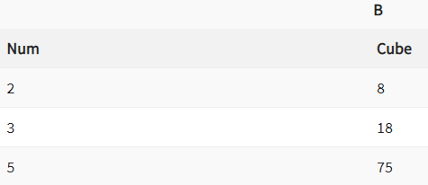
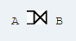
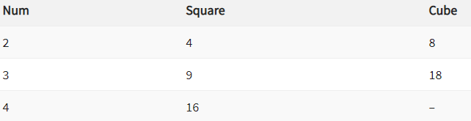
Left Outer Join

Slide 29
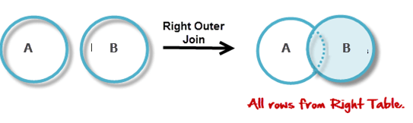
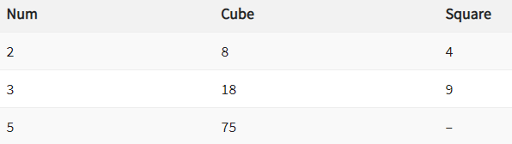
Right Outer Join: ( A B )
In the right outer join, operation allows keeping all tuple in the right relation. However, if there is no matching tuple is found in the left relation, then the attributes of the left relation in the join result are filled with null values.
( A B )

Slide 30
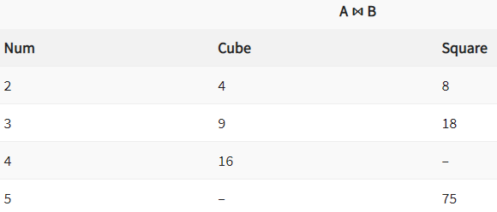
Full Outer Join: ( A B)
In a full outer join, all tuples from both relations are included in the result, irrespective of the matching condition.
A B

Slide 31
Operation(Symbols) | Purpose
Select(σ) | The SELECT operation is used for selecting a subset of the tuples according to a given selection condition
Projection(π) | The projection eliminates all attributes of the input relation but those mentioned in the projection list.
Union Operation(∪) | UNION is symbolized by symbol. It includes all tuples that are in tables A or in B.
Set Difference(-) | – Symbol denotes it. The result of A – B, is a relation which includes all tuples that are in A but not in B.
Intersection(∩) | Intersection defines a relation consisting of a set of all tuple that are in both A and B.
Cartesian Product(X) | Cartesian operation is helpful to merge columns from two relations.
Inner Join | Inner join, includes only those tuples that satisfy the matching criteria.
Theta Join(θ) | The general case of JOIN operation is called a Theta join. It is denoted by symbol θ.
EQUI Join | When a theta join uses only equivalence condition, it becomes a equi join.
Natural Join(⋈) | Natural join can only be performed if there is a common attribute (column) between the relations.
Outer Join | In an outer join, along with tuples that satisfy the matching criteria.
Left Outer Join( ) | In the left outer join, operation allows keeping all tuple in the left relation.
Right Outer join() | In the right outer join, operation allows keeping all tuple in the right relation.
Full Outer Join() | In a full outer join, all tuples from both relations are included in the result irrespective of the matching condition.

Slide 32
Example Queries on Relational Algebra
(1). Suppose there is a banking database which comprises following tables :
Customer(Cust_name, Cust_street, Cust_city)
Branch(Branch_name, Branch_city, Assets)
Account (Branch_name, Account_number, Balance)
Loan(Branch_name, Loan_number, Amount)
Depositor(Cust_name, Account_number)
Borrower(Cust_name, Loan_number)
Query : Find the names of all the customers who have taken a loan from the bank and also have an account at the bank.
Solution:

Slide 33
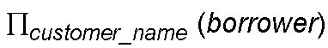
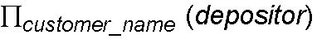
Depositor(Cust_name, Account_number)
Borrower(Cust_name, Loan_number)
Query : Find the names of all the customers who have taken a loan from the bank and also have an account at the bank.
Solution:
Step 1 : Identify the relations that would be required to frame the resultant query.
First half of the query(i.e. names of customers who have taken loan) indicates “borrowers” information.
So Relation 1 —–> Borrower.
Second half of the query needs Customer Name and Account number which can be obtained from Depositor relation.
Hence, Relation 2——> Depositor.
Step 2 : Identify the columns which you require from the relations obtained in Step 1.
Column 1 : Cust_name from Borrower
Column 2 : Cust_name from Depositor
Step 3 : Identify the operator to be used. We need to find out the names of customers who are present in both Borrower table and Depositor table.
Hence, operator to be used—-> Intersection.
Final Query will be

Slide 34
What is the result of first performing the cross product of student and advisor, and then performing a selection operation on the result with the predicate s _id = ID?
σ S_id=ID (student × advisor)

Slide 35
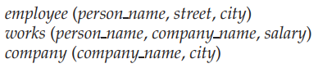
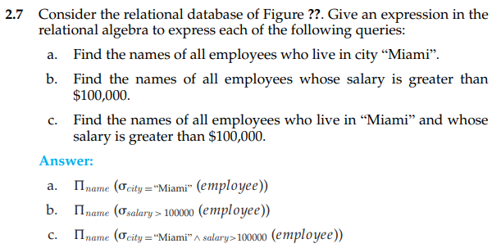
works
Employee ⋈ works

Slide 36
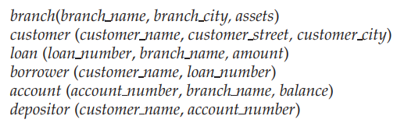
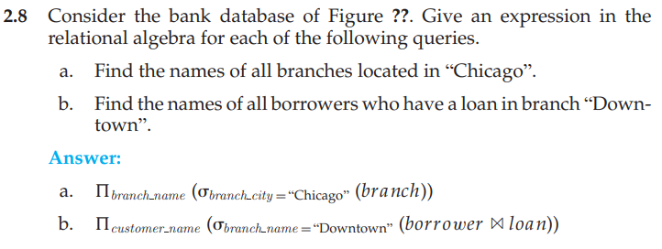

Slide 37
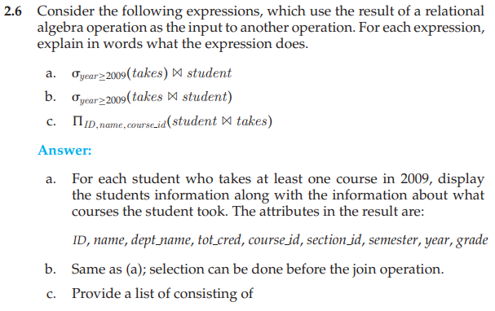
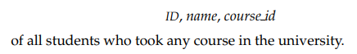

Slide 38
Mapping the ER and EER Model to the Relational Model

Slide 39
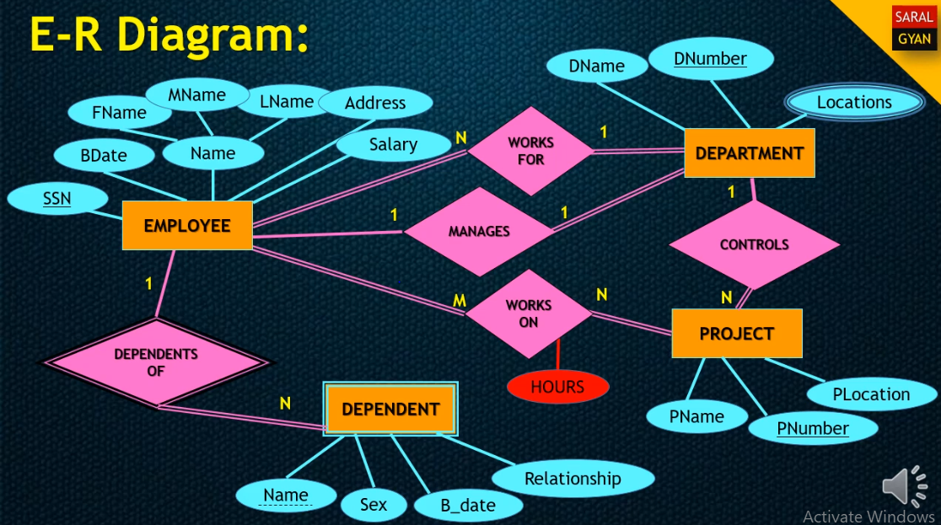

Slide 40
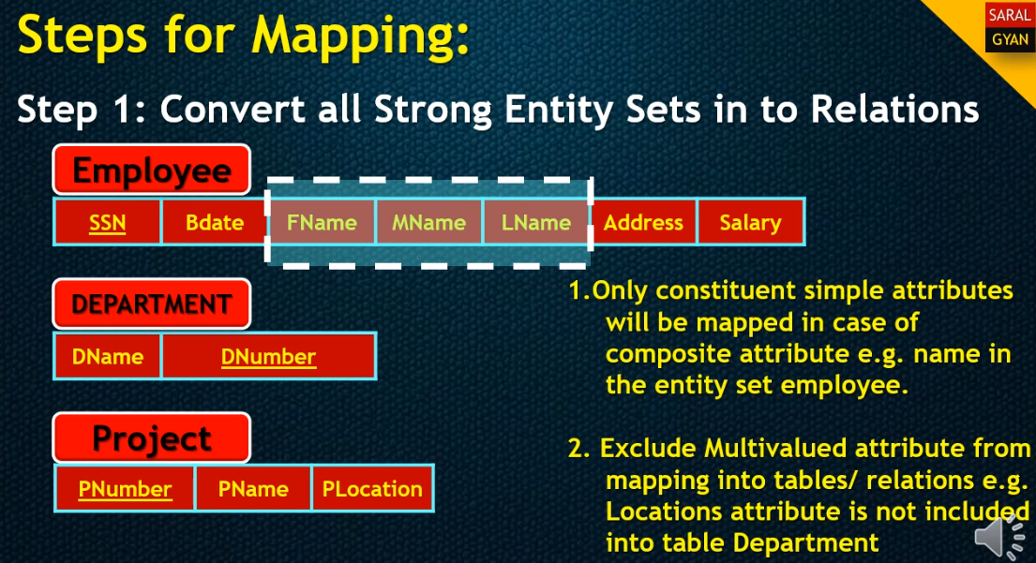

Slide 42
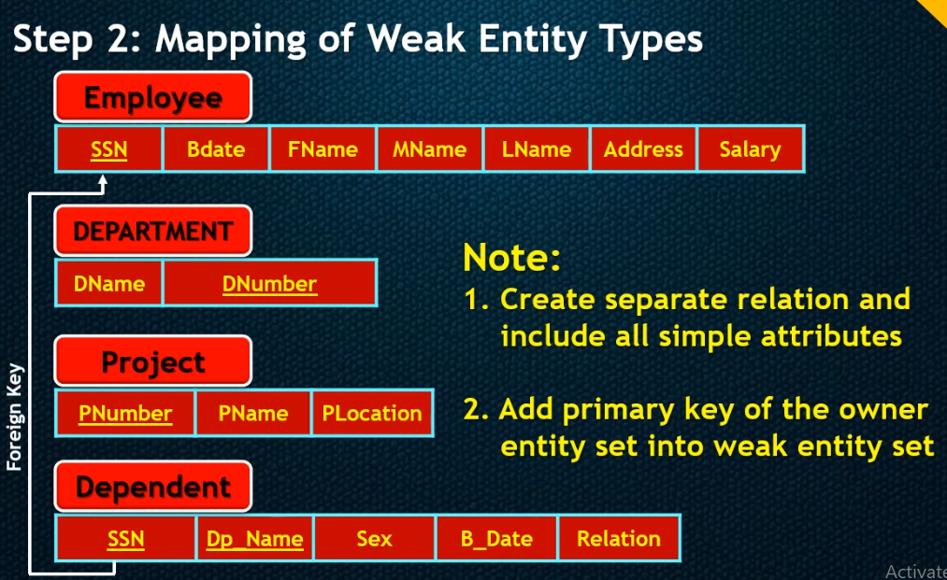

Slide 43
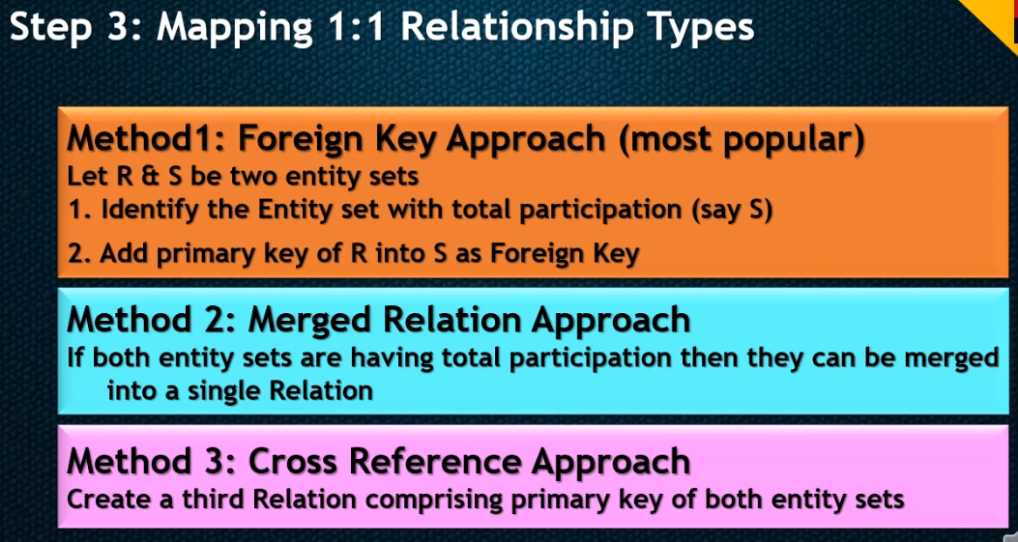

Slide 45
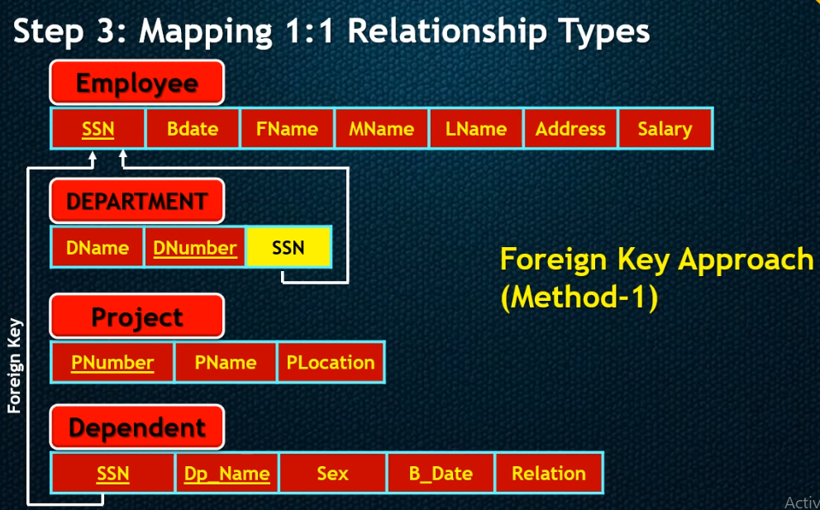

Slide 46
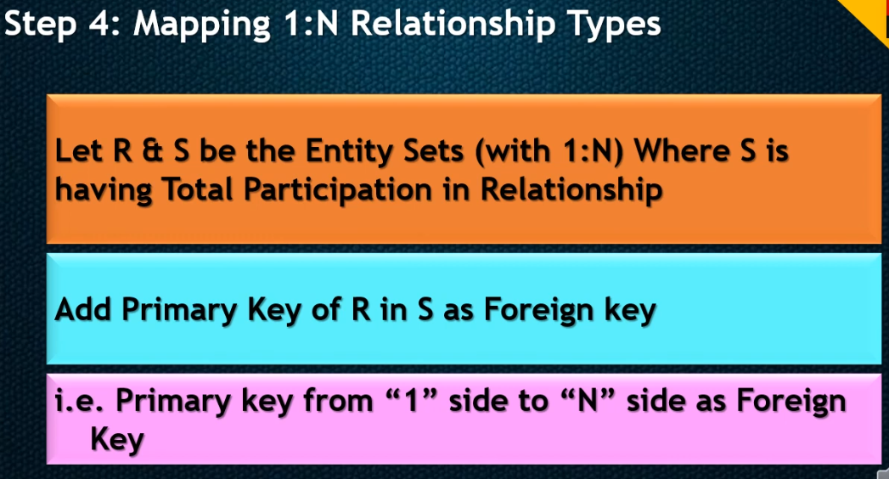

Slide 48
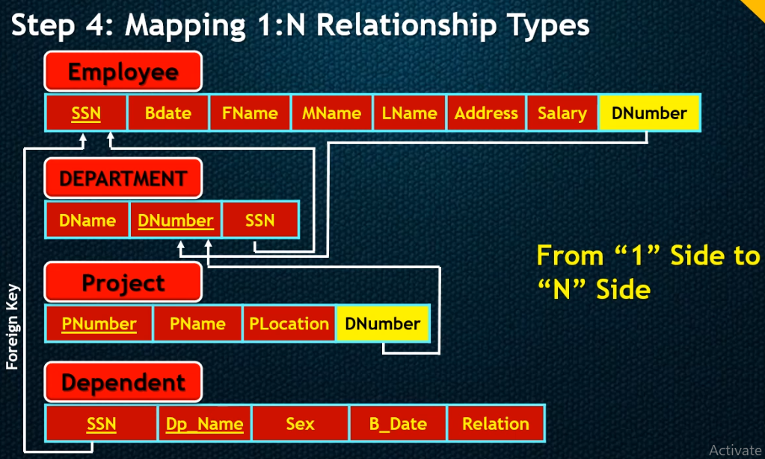

Slide 49
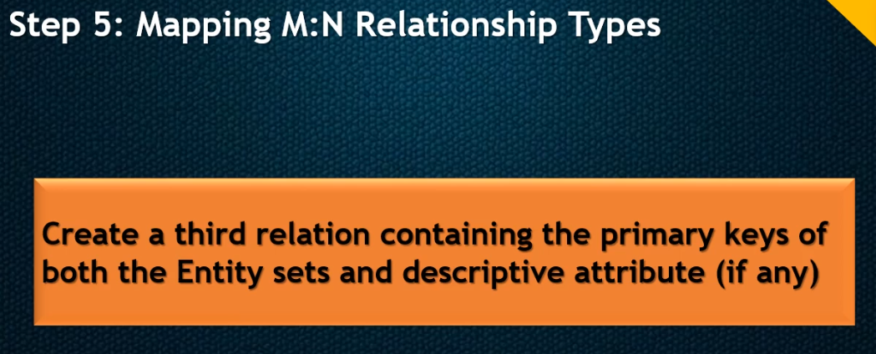

Slide 51
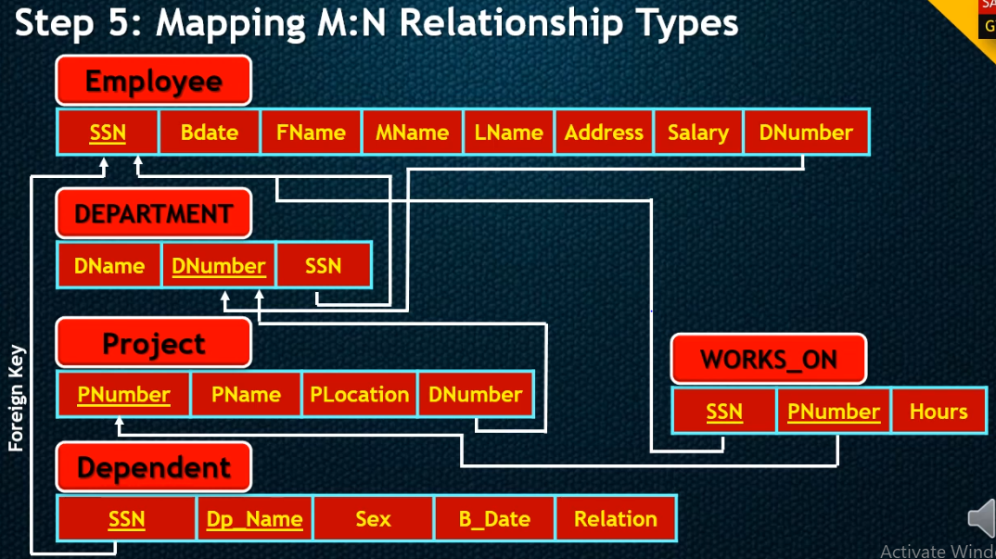

Slide 52
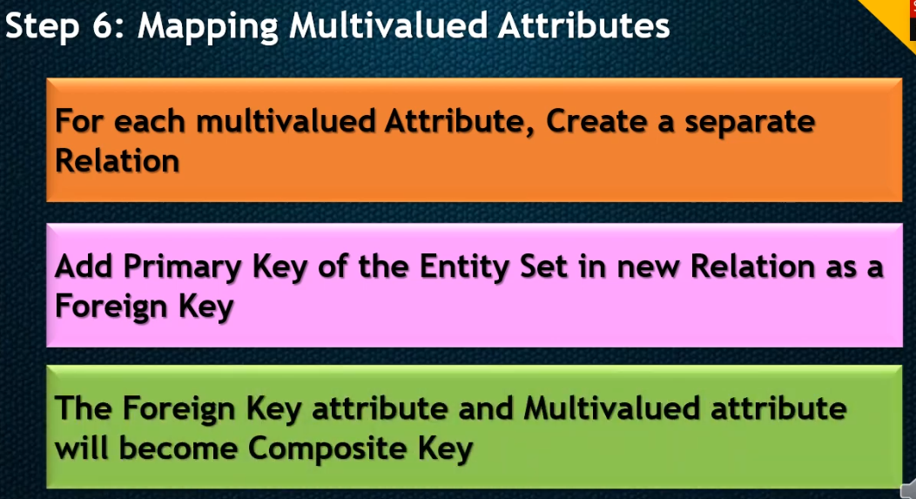

Slide 54


Slide 55


Slide 56

Some examples of Relational schemas
Map the given ER diagram to Relational schema.

Slide 57


Slide 58


Slide 59


Slide 60

Map the given ER diagram to Relational schema.

Slide 61

Relational database schema

Slide 62

Map the given ER diagram to Relational schema.

Slide 64

Map the given ER diagram to Relational schema.

